Slide 1



CATCHING THE UNUSUAL
USING AI TO DETECT MONEY LAUNDRING AT AMARCORD
Musharraf Hussain 26543
Kawnain Khan 26057
Umar Khan
Muhammad Ali Mithani 25900
Hammad Shahzad 28294
Group 10

Slide 2

OUT OF CONTEXT

Slide 3

OVERVIEW
Amarcord is a $40 billion asset regional bank holding company headquartered in New Orleans, Louisiana.
Amarcord provides various services such as consumer banking, equipment leasing, and investment banking services.
The services are distributed through conventional channels of 250 branches and also digital channels such as internet banking

Slide 4

THE BUSINESS PROBLEM:
“When Routine Transactions Raise Red Flags”
Amarcord Incorporated, like many financial institutions, faces increasing pressure to detect and report suspicious activity — especially in a landscape where money laundering methods are becoming more sophisticated.
One unusual case raised concern: a swimwear retail account regularly receiving wire transfers exceeding $500,000 — a volume far beyond what would typically be expected for such a business.
While most customers follow predictable patterns, anomalies like these require deeper analysis. Not every large deposit is suspicious — but some are just suspicious enough to investigate.

Slide 5

RECENT
MONEY LAUNDERING
SCANDALS
BNP Paribas, Concealing billions of dollars in FATF black-listed countries.
HSBC, allowing itself to be used for money laundering of drug money
Barclays, violations of US sanctions for almost a decade

Slide 6

WHY TRADITIONAL METHODS FAIL?
Rules-based systems often generate too many false positives.
Money launderers are getting smarter; our tools need to be smarter too.

Slide 7

OUR AI-DRIVEN SOLUTION
ISOLATION FOREST
Unsupervised algorithm to flag outliers.
Isolation Forests are a machine learning algorithm that uses classification to detect anomalies and is built based on decision trees. Since there are no pre-defined labels here, it is an unsupervised model.
It isolates anomalies using a multitude of decision trees each distinguishing using a different feature, instead of constructing a normal profile then classifying anomalies based on deviation. The method uses a collection of these trees to calculate anomaly scores for each instance and then uses the average to output a score.
Think of it as: “Who's acting strangely in the group?” without constructing a ‘normal’ profile initially.

Slide 8
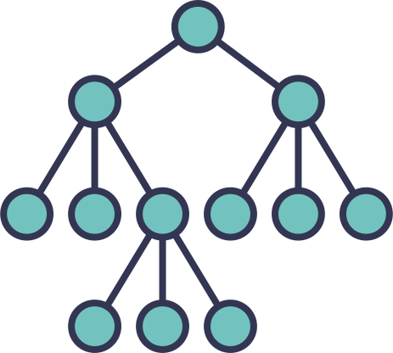
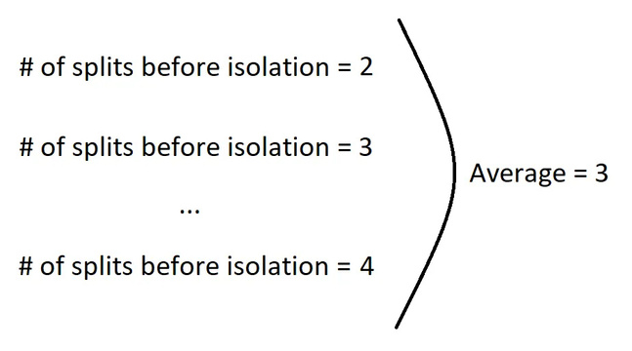
ISOLATION FOREST IN THEORY
It is a classification algorithm made up on a multitude of different decision trees.
From the given set of features, it randomly selects one and then using given directions randomly selects a min and max value of the feature.
Isolation forest works on the principle that during the random partitioning of features, the ANOMALOUS data points will produce shorter stems as they will be easier to isolate.
Within a few random partitions, the anomalies will be able to distinguish themselves from the “normal” data points
This process of creating new leaves is repeated until each data point is isolated from the other in a separate leaf within the decision tree.
The anomaly score use reported as an average of scores received from each tree

Slide 9

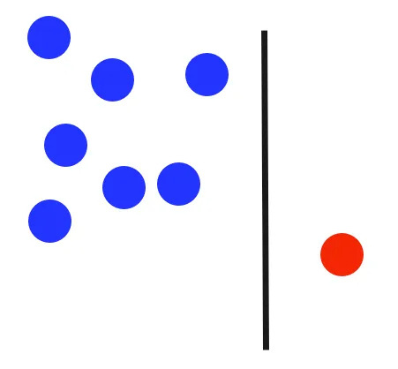
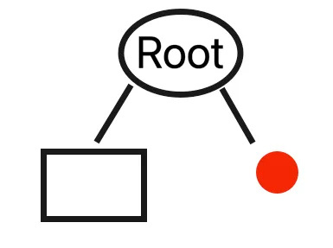
1.
SUPPOSE WE HAVE A RANDOM SELECTION OF DATA POINTS AS SUCH
2.
THE ALGORITHM SELECTS A RANDOM FEATURES
AND SPLITS THE DATA ACCORDINGLY
3.
REPRESENTED IN A CLASSIFICATION TREE, THIS IS WHAT IT WOULD LOOK LIKE,
THE ANOMALY IN ONE RIGHT NODE AND THE REST OF THE POINTS IN THE LEFT LEAF

Slide 10
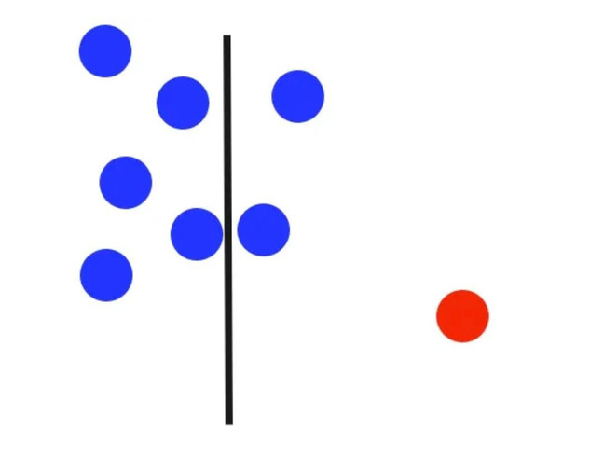
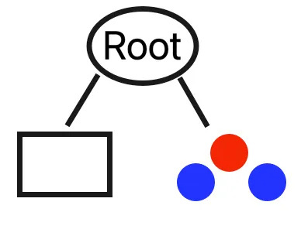
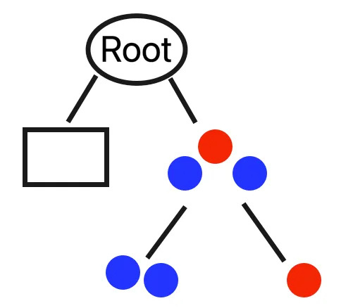
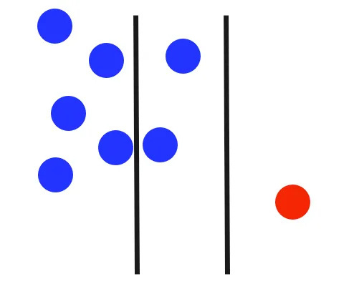
1.
2.
IN A DIFFERENT TREE, HOWEVER, THE FEATURE DOES NOT ISOLATE THE ANOMALY IN THE FIRST SPLIT.
WE END UP WITH SUCH A TREE WHERE THERE ARE 2 NODES, ONE ON THE LEFT CONTAINING NORMAL DATA POINTS AND ONE ON THE RIGHT CONTAINING THE ANOMALY WITH A FEW DATA POINTS AND THIS NEEDS TO BE ISOLATED FURTHER
3.
4.
FURTHER ISOLATION IS DONE SO THAT EACH LEFT CONTAINS A SINGLE DATA POINT FROM THE INITIAL DATA
SINCE OUR SECOND ITERATION MANAGES TO ISOLATE THE OUTLIER, ITS DECISION TREE WOULD LOOK LIKE THIS
WE COULD HAVE A DIFFERENT DIMENSION FOR THE THIRD DECISION TREE WHICH MAY REQUIRE FURTHER SPLIT AND SO ON UNTIL MAXIMUM DEPTH IS REACH OR EACH NODE HAS ONLY ONE INSTANCE.

Slide 11
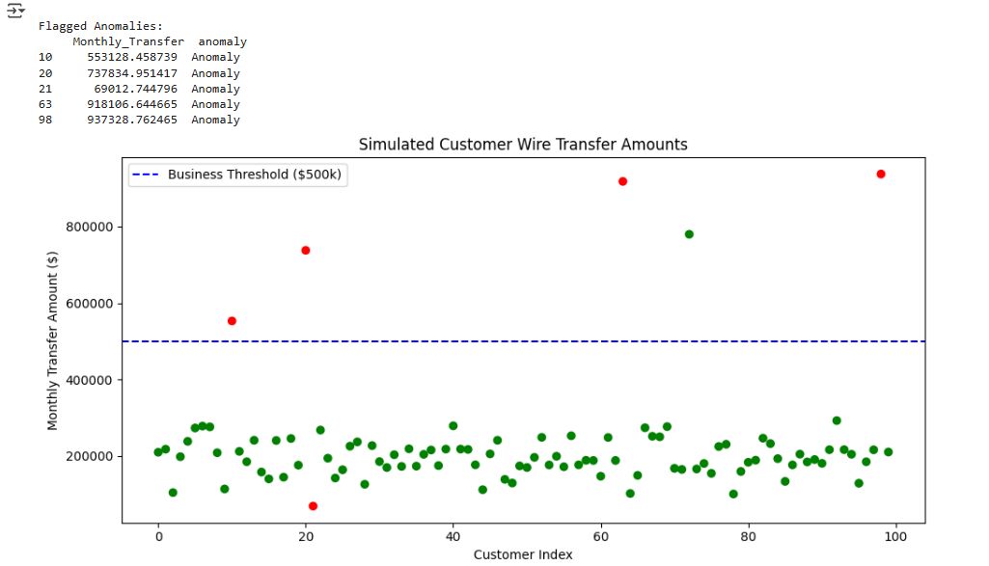
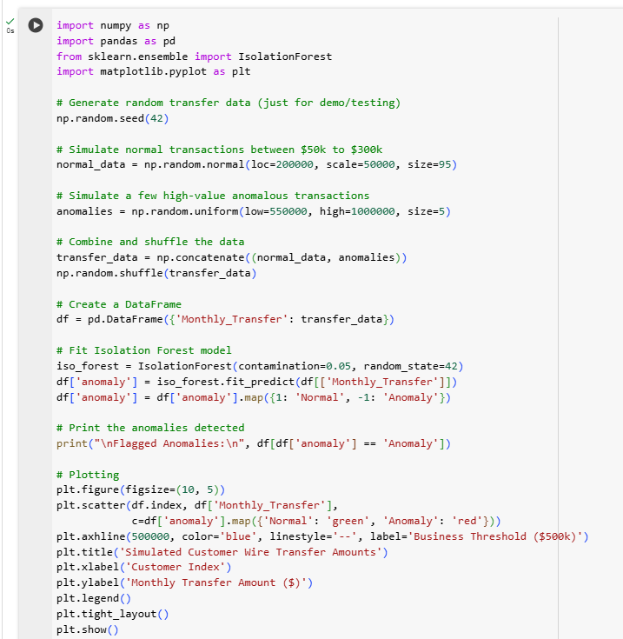
SCATTER PLOT
We created a sample code for our understanding in a python environment, using the swimwear company’s as a basis and limiting the transactions to within 500k, and flagging the rest as anomalies.
As we see from our scatter plot there are about 5 red dots, representing anomalies, while the rest are all flagged green, representing normal points.
While there are 2 unexpected outputs flagged incorrectly, most of the points, i.e. 4 anomalies are correctly detected and 1 is incorrectly flagged as an anomaly while 1 anomaly is incorrectly flagged as a normal data point.
Further iterations are required to fully visualize it but this does give us a good picture into how our actual product would work to detect potential money laundering transactions effectively and efficiently using AI and machine learning

Slide 12
ADVANTAGES OF ISOLATION FOREST
1. Works Well with Unlabeled Data
No need for pre-labeled fraud cases.
Perfect for Amarcord’s situation where suspicious transactions may not yet be confirmed as money laundering.
3. Effective at Detecting Rare Anomalies
Since money laundering is rare compared to normal transactions, Isolation Forest is built to spot the needle in a haystack.
It isolates outliers instead of profiling normal behavior, which is useful in unpredictable fraud scenarios.
2. Efficient for High-Dimensional and Large Datasets
Handles large volumes of transaction data quickly.
Scales well — making it ideal for a bank analyzing thousands of accounts.
4. Interpretable Anomaly Scores
Assigns a score to each transaction or customer indicating how anomalous it is.
Easy for compliance teams to review and prioritize high-risk cases.

Slide 13
MORE
ADVANTAGES
5. Robust to Irrelevant Features
Less sensitive to noisy or uninformative variables.
Helps when the data includes complex financial attributes that may not all be useful.
7. Fast to Train and Tune
Quick to deploy for real-time or near-real-time analysis.
Great for a pilot study where time and resources are limited.
6. No Need for Data Normalization
Unlike many ML models, Isolation Forest doesn’t require scaling or normalization of features.
This saves preprocessing time and effort.

Slide 14
THANK YOU

